Slide 1

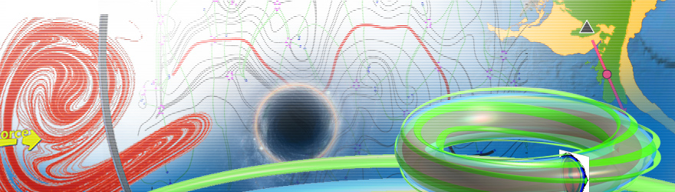
生物动力系统模拟
王冠宇 18665955633
wanggy@sustc.edu.cn

Slide 2
Methods for Determining
Atomic Structures

Slide 3
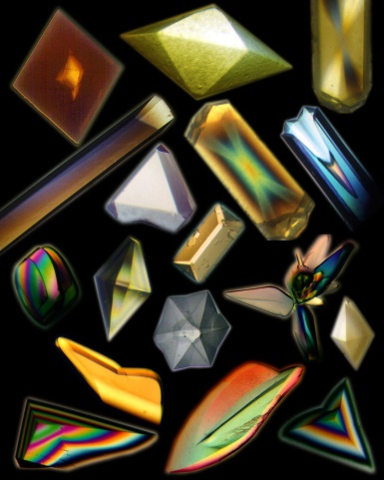
X-ray Crystallography:
Protein purification
Protein crystallization : The protein solution becomes supersaturated,
so that individual protein molecules can pack in
a repeating array, held together by noncovalent interactions.
Crystals of proteins grown on the U.S.
Space Shuttle or Russian Space Station
Shortcomings: it is difficult to obtain crystals, especially those large, complex proteins.
X-ray diffraction: The proteins in the crystal diffract the X-ray beam into one or another
characteristic pattern of spots, which are then analyzed (with some tricky methods to
determine the phase of the X-ray wave in each spot) to determine the distribution of
electrons in the protein. The resulting map of the electron density is then interpreted to
determine the location of each atom.

Slide 4
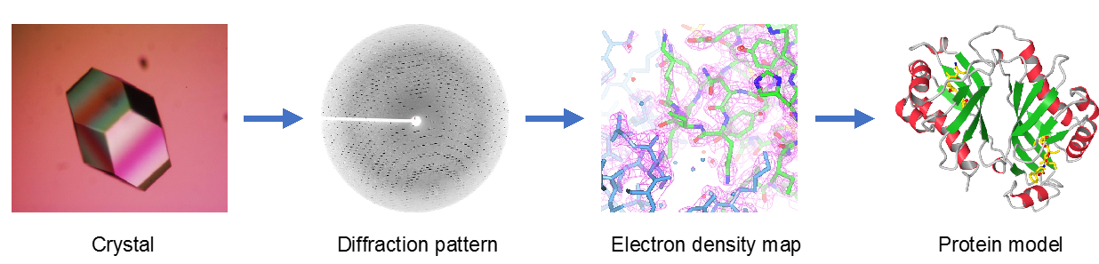
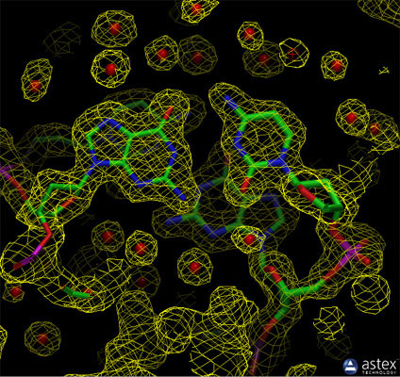
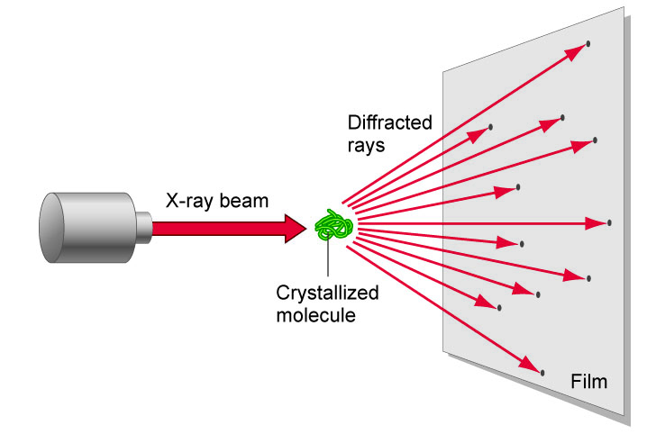

Slide 5
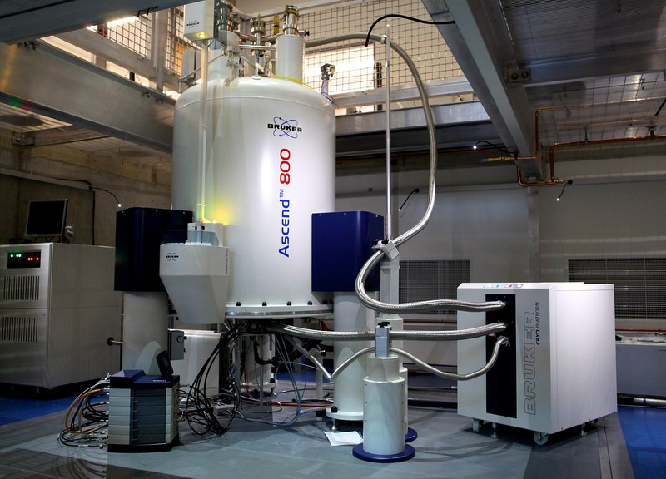
NMR Spectroscopy

Slide 6
NMR Spectroscopy
(comparison with X-ray)
Sample: proteins in solution vs crystal
A major advantage of NMR spectroscopy is that it provides information on proteins in solution, as opposed to those locked in a crystal or bound to a microscope grid, and thus, NMR spectroscopy is the premier method for studying the atomic structures of flexible proteins.
Probing matter: radio wave vs X-ray
Resultant pattern: atomic resonance pattern vs diffraction pattern
Advantages: flexible vs fixed
Disadvantages: small proteins vs Larger proteins
large proteins present problems with overlapping peaks in the NMR spectra.

Slide 7
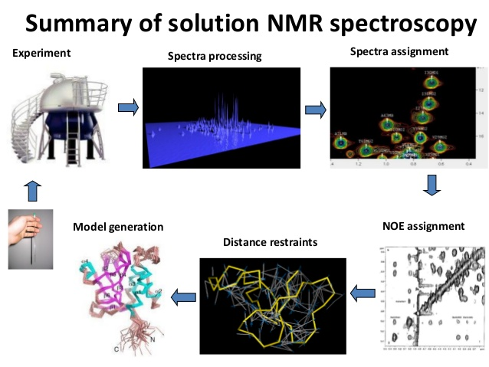

Slide 8
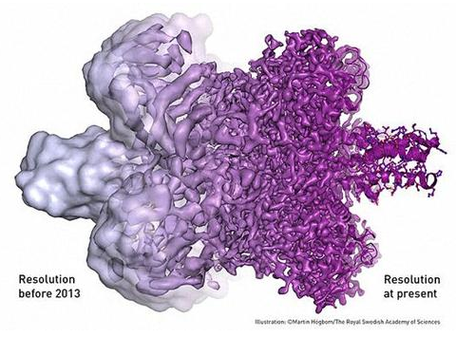
Cryo-electron microscopy
1. The basic principle is diffraction, now we use electrons instead of X-ray.
2. High resolution
3. Why high resolution
Because high resolution corresponds to small wavelength
Electrons are more like particles, having very small wavelength

Slide 9
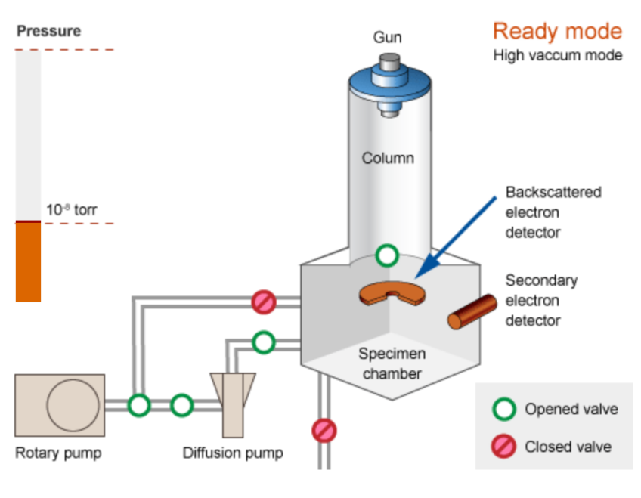
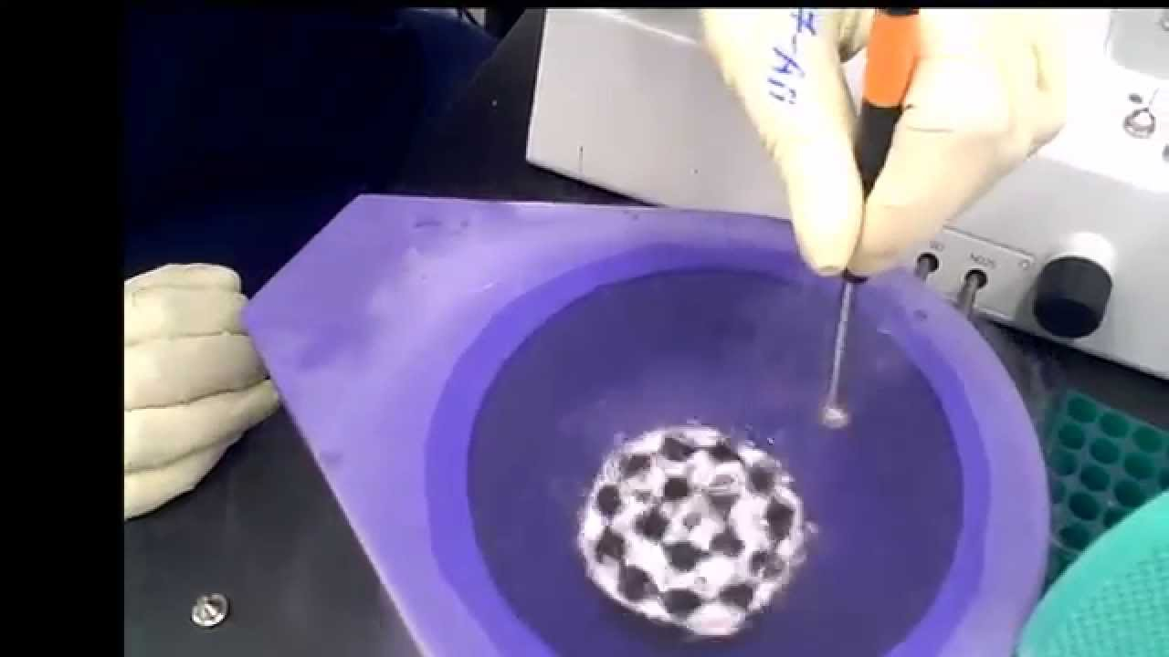
3. Why under cryogenic temperatures ?
Vacuum is required in the Column to
avoid electrons being scattered.
But high vacuum would damage the specimen,
vaporizing molecules.
The solution is to freeze the sample
Slow freezing does not solve the problem,
because water becomes ice (crystal) which distort the protein molecule
The solution is “flash freezing”, so fast that
The sample is frozen even before the re-organization of water molecules into crystall.
This can be done by liquid nitrogen!

Slide 10
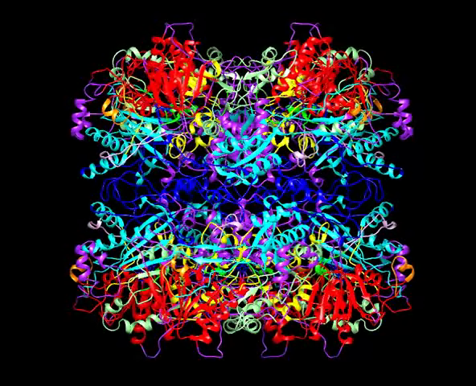

Slide 11
Introduction to PDB files

Slide 12
The PDB archive is a repository of atomic coordinates and other information describing proteins and other important biological macromolecules. Structural biologists use methods such as X-ray crystallography, NMR spectroscopy, and cryo-electron microscopy to determine the location of each atom relative to each other in the molecule. They then deposit this information, which is then annotated and publicly released into the archive by the wwPDB.
you can go to the PDB archive to find structures for ribosomes, oncogenes, drug targets, and even whole viruses. However, it can be a challenge to find the information that you need, since the PDB archives so many different structures. You will often find multiple structures for a given molecule, or partial structures, or structures that have been modified or inactivated from their native form.

Slide 13
An example PDB file
Number in the file
Name
Residue number
Atoms in proteins,
DNA, RNA
occupancy
Residue name
ATOM 1 N ASN 1 3.326 1.548 -0.000 1.00 0.00
ATOM 2 H1 ASN 1 4.046 0.840 -0.000 1.00 0.00
ATOM 3 H2 ASN 1 2.823 1.500 -0.875 1.00 0.00
ATOM 4 H3 ASN 1 2.823 1.500 0.875 1.00 0.00
ATOM 5 CA ASN 1 3.970 2.846 -0.000 1.00 0.00
ATOM 6 HA ASN 1 3.672 3.400 -0.890 1.00 0.00
ATOM 7 CB ASN 1 3.577 3.654 1.232 1.00 0.00
ATOM 8 2HB ASN 1 2.497 3.801 1.241 1.00 0.00
ATOM 9 3HB ASN 1 3.877 3.116 2.131 1.00 0.00
ATOM 10 CG ASN 1 4.254 5.017 1.232 1.00 0.00
ATOM 11 OD1 ASN 1 5.005 5.340 0.315 1.00 0.00
ATOM 12 ND2 ASN 1 3.985 5.818 2.266 1.00 0.00
ATOM 13 1HD2 ASN 1 4.408 6.734 2.315 1.00 0.00
ATOM 14 2HD2 ASN 1 3.360 5.504 2.994 1.00 0.00
ATOM 15 C ASN 1 5.486 2.705 -0.000 1.00 0.00
ATOM 16 O ASN 1 6.009 1.593 -0.000 1.00 0.00
ATOM 17 N LEU 2 6.191 3.839 -0.000 1.00 0.00
ATOM 18 H LEU 2 5.715 4.730 -0.000 1.00 0.00
ATOM 19 CA LEU 2 7.640 3.839 -0.000 1.00 0.00
ATOM 20 HA LEU 2 8.004 3.325 0.890 1.00 0.00
ATOM 21 CB LEU 2 8.189 3.127 -1.232 1.00 0.00
ATOM 22 2HB LEU 2 7.841 2.094 -1.241 1.00 0.00
Temperature
factor
HETATM
HETATM
HETATM
HETATM
HETATM
Atoms in non-standard molecules, including:
inhibitors, cofactors, ions, and solvent (e.g. H2O)

Slide 14
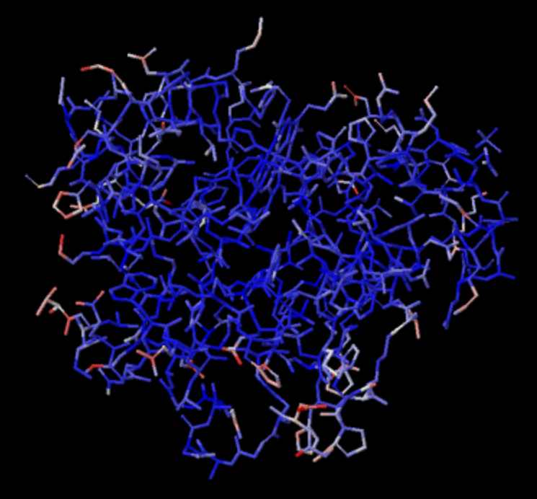
Temperature factor (B factor)
It measures uncertainty in the atom’s position
If the value is high, the atom is probably moving a lot, and the coordinates specified
in the PDB file are only one possible snapshot of its location.
It shows the whole molecule, with the atoms colored by the temperature factors. High values, indicating lots of motion, are in red and yellow, and low values are in blue. Notice that the interior of the protein has low B-values and the amino acids on the surface have higher values.

Slide 15
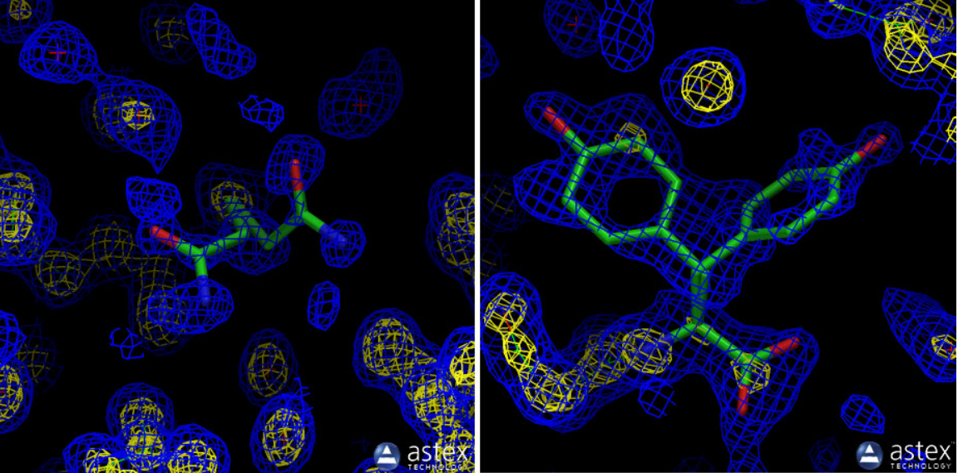
Occupancy
A crystal does not contain a single molecule, it contains many repetitions of it.
Differences may exist between these repetitive molecules:
A side chain may change orientations
A substrate may bind in different orientations
A metal ion may be bound to only a few of the molecules
…
glutamine 8
tyrosine 151
50%
50%
57%
43%
ATOM 1 N GLN 8 x y z 0.57 0.00
ATOM 2 N GLN 8 x y z 0.43 0.00
ATOM 33 C TYR 151 x y z 0.50 0.00
ATOM 34 C TYR 151 x y z 0.50 0.00

